Slide 1
Predicting Seasonal Flu Vaccine Uptake
Addressing Vaccine Hesitancy Using Machine Learning

Slide 2
Overview
Objective: Create a model to predict seasonal flu vaccine uptake based on individual backgrounds and behaviors.
Importance: Understanding vaccine hesitancy helps in planning effective public health campaigns.
Goal: Achieve an accuracy of at least 80% in predicting who will get vaccinated.

Slide 3
Business and Data Understanding
Problem Statement:
Vaccine hesitancy poses a significant threat to global health, especially during pandemics.
Understanding the factors behind vaccine reluctance can help mitigate risks and improve public health responses.
Data Sources:
Demographic information (age, education, income)
Behavioral patterns (use of face masks, handwashing)
Medical history (chronic conditions, health worker status)
Opinions on vaccines (effectiveness, risks)

Slide 4
Modeling
Approach:
We used various machine learning models to predict vaccine uptake.
Models included Logistic Regression, Random Forest, Gradient Boosting, and XGBoost.
Each model was trained and evaluated for accuracy, precision, recall, and ROC AUC score.
Why Classification?
Classification helps us categorize individuals into two groups: those who will get vaccinated and those who won't.
This allows targeted interventions and better resource allocation.

Slide 5
Modelling Process Flowchart
Data Preparation
Compare Model
Performance
(Select Best Model)
Feature Importance | Analysis (SHAP)
Data Preprocessing
Model Evaluation on
Test Dataset (Accuracy, ROC AUC)
Final Model &
Recommendations
Model Training
(Logistic Reg,
Random Forest,
Gradient Boosting,
XGBoost)
Split Data into Train & Test

Slide 6
Modelling Continued
Models Compared:
Baseline Model (Logistic Regression):
Accuracy: 80.81%
ROC AUC Score: 0.878
Random Forest:
Accuracy: 80.78%
ROC AUC Score: 0.8782

Slide 7
Modelling Continued.
Gradient Boosting:
Accuracy: 81.26%
ROC AUC Score: 0.8847
XGBoost: Best overall performance
Accuracy: 81.25%
ROC AUC Score: 0.8850

Slide 8
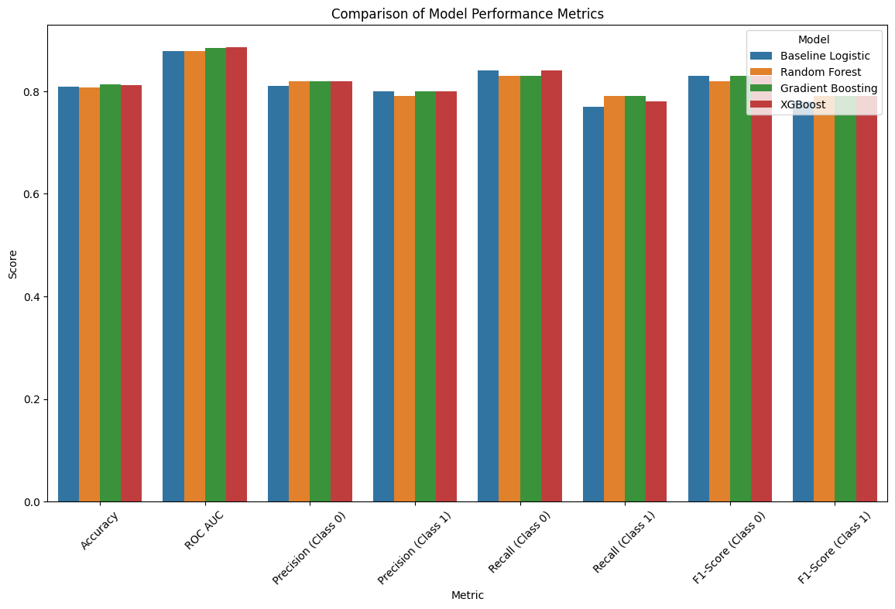
Comparison of Model Performance Metrics

Slide 9
Evaluation
Key Metrics Explained:
Accuracy: Overall correctness of the model’s predictions.
Precision: How often the model’s positive predictions are correct.
Recall: How well the model identifies all actual positives.
ROC AUC Score: Measures the ability of the model to distinguish between classes.

Slide 10
Evaluation Continued
XGBoost Results:
Accuracy: 81.25%
ROC AUC Score: 88.50%
High precision and recall for both vaccinated and non-vaccinated groups.

Slide 11
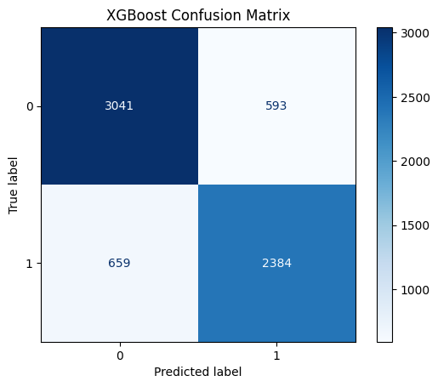
Confusion Matrix for XGBoost

Slide 12
Feature Importance (SHAP Analysis)
Top Influential Factors:
Doctor Recommendation: Strongly encourages vaccination.
Opinion on Vaccine Effectiveness: Positive beliefs increase uptake.
Past Vaccine Behavior: Those who took the H1N1 vaccine are likely to take the flu vaccine.
Interpretation:
Recommendations from healthcare professionals and positive opinions about vaccines play crucial roles in vaccine uptake.
Understanding these factors helps tailor public health messages.

Slide 13
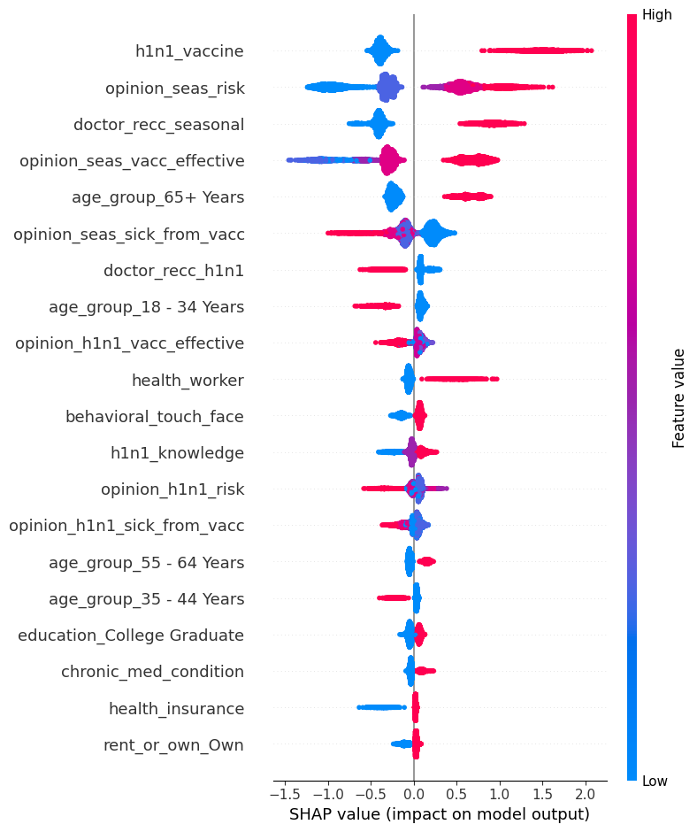
SHAP Summary Plot

Slide 14
Recommendations
Targeted Campaigns:
Focus on younger and older age groups, lower education levels, and lower-income individuals.
Doctor Engagement:
Encourage doctors to recommend vaccines strongly.
Community Initiatives:
Use trusted community figures to spread accurate information.
Improve Access:
Provide free or low-cost vaccination clinics in convenient locations.

Slide 15
Next Steps
Enhance Data Collection:
Gather more detailed behavioral and opinion data.
Model Refinement:
Continuously update models with new data to improve accuracy.
Policy Advocacy:
Work with policymakers to remove barriers to vaccination and support public health initiatives.

Slide 16
Contact information
For further information contact Magdalene Ondimu at magdalene.ondimu@student.moringaschool.com

